Slide 1

Getting Started
DAVID M. KROENKE and DAVID J. AUER
DATABASE CONCEPTS, 7th Edition
Chapter One

Slide 2
Chapter Objectives
Identify the purpose and scope of this book
Know the potential problems with lists
Understand the reasons for using a database
Understand how using related tables helps you avoid the problems of using lists
Know the components of a database system
Learn the elements of a database
Learn the purpose of the database management system (DBMS)
Understand the functions of a database application
Introduce non-relational databases

Slide 3
Purpose of a Database
The purpose of a database is to keep track of things.
Unlike a list or spreadsheet, a database may store information that is more complicated than a simple list.

Slide 4
Problems with Lists: Redundancy
In a list, each row is intended to stand on its own. As a result, the same information may be entered several times.
For Example: A list of Projects may include the Project Manager’s Name, ID, and Phone Extension. If a particular person is managing 10 projects, his/her information would have to be entered 10 times.

Slide 5
Problems with Lists: Multiple Themes
In a list, each row may contain information on more than one theme. As a result, needed information may appear in the lists only if information on other themes is also present.
For Example: A list of Projects may include Project Manager information (Name, ID, and Phone Extension) and Project information (Name, ID, StartDate, Budget) in the same row.

Slide 6
List Modification Issues
Redundancy and multiple themes create modification problems:
Deletion problems
Update problems
Insertion problems

Slide 7
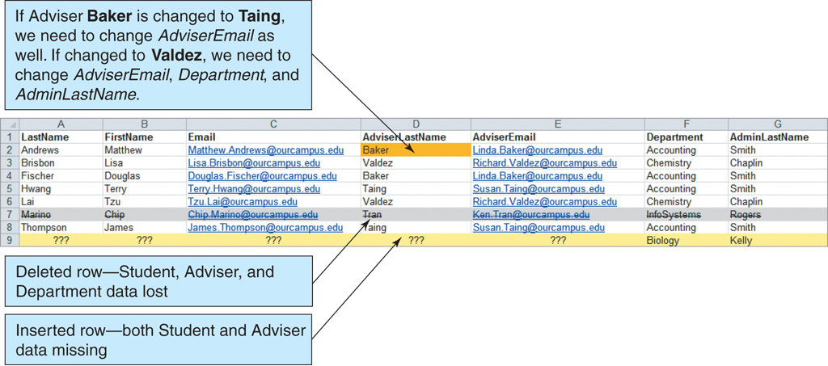
List Modification Issues (Cont’d)
Figure 1-5: The Student with Adviser and Department List

Slide 8
Addressing Information Complexities
Relational databases are designed to address many of the information complexity issues.

Slide 9
Relational Databases
A relational database stores information in tables. Each informational topic is stored in its own table.
In essence, a relational database will break-up a list into several parts—one part for each theme in the list.
A Project List would be divided into a CUSTOMER Table, a PROJECT Table, and a PROJECT_MANAGER Table.

Slide 10
Putting the Pieces Back Together
In our relational database, we broke our list into several tables. Somehow the tables must be joined back together.
In a relational database, tables are joined together using the value of the data.
If a PROJECT has a CUSTOMER, the Customer_ID is stored as a column in the PROJECT table. The value stored in this column can be used to retrieve specific customer information from the CUSTOMER table.

Slide 11
Sounds Like More Work, Not Less
A relational database is more complicated than a list.
However, a relational database minimizes data redundancy, preserves complex relationships among topics, and allows for partial data.
Furthermore, a relational database provides a solid foundation for user forms and reports.

Slide 12
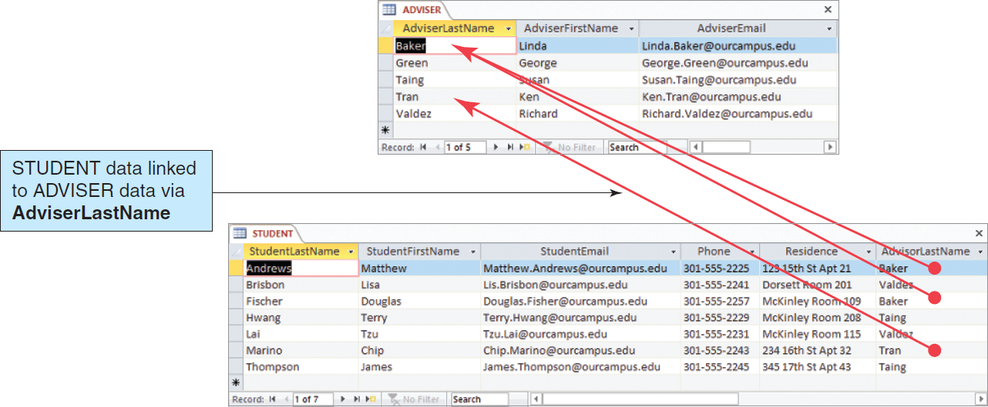
Relational Database Example
Figure 1-6: The Adviser and Student Tables

Slide 13
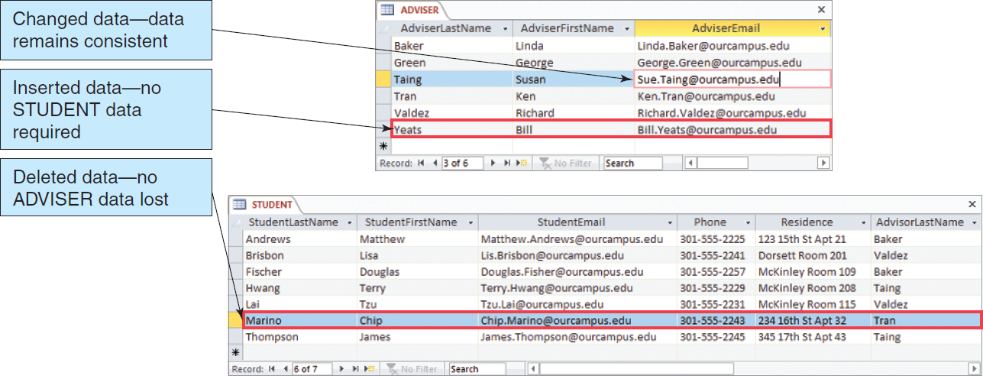
A Relational Database Solves the Problems of Lists
Figure 1-7: Modifying the Adviser and Student Tables

Slide 14
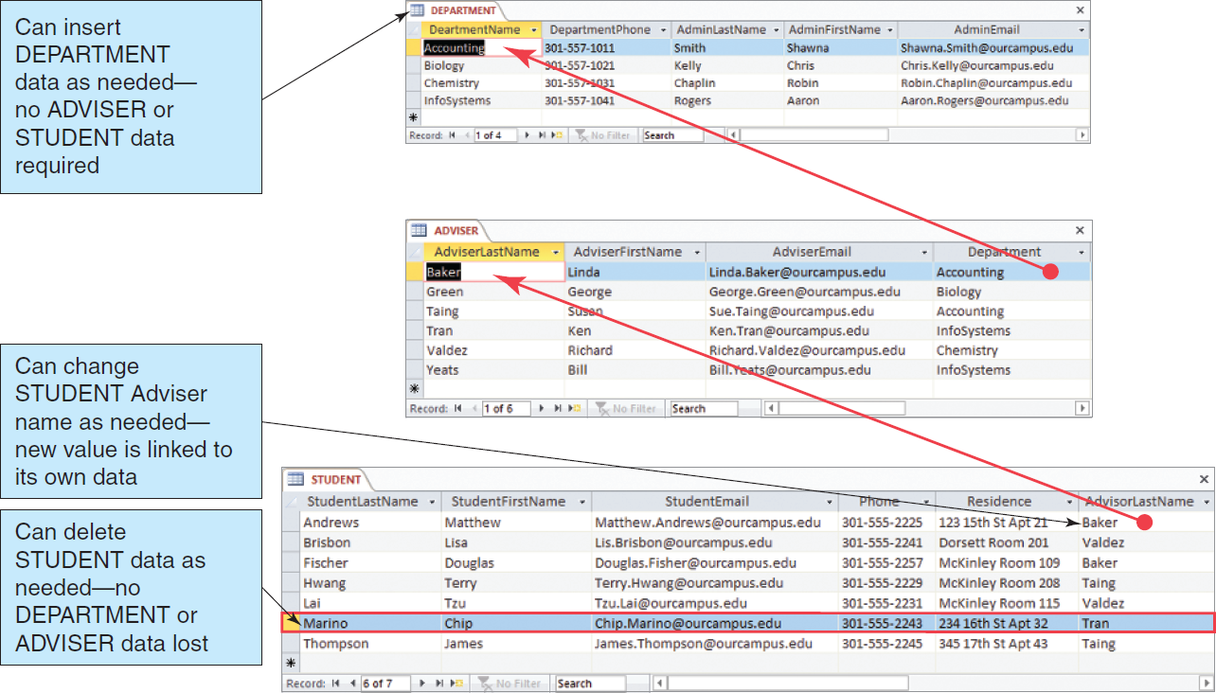
The Department, Advisor and Student Tables
Figure 1-8: The Department, Adviser, and Student Tables

Slide 15
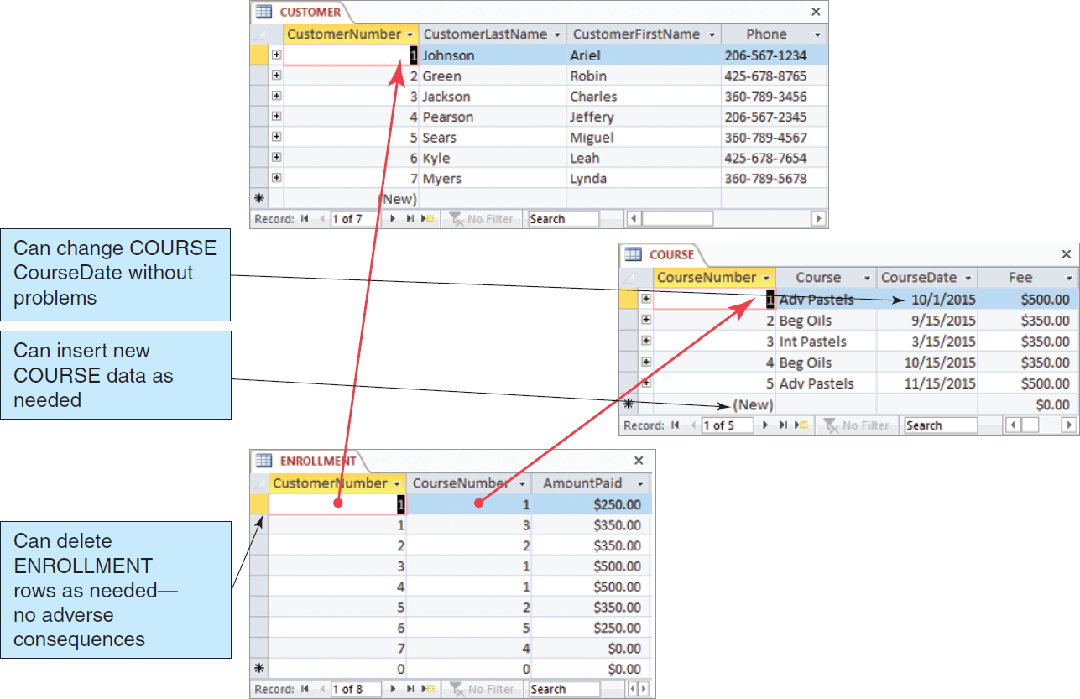
The Art Course Database Tables
Figure 1-10: The Art Course Database Tables

Slide 16
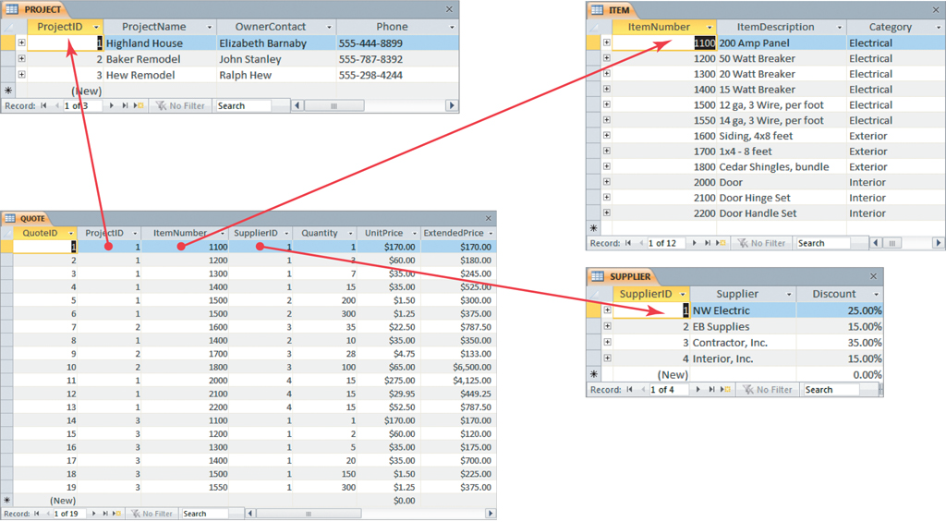
The Project Equipment Tables
Figure 1-12: The Project Equipment Database Tables

Slide 17
Structured Query Language (SQL)
Structured Query Language (SQL) is an international standard for creating, processing and querying databases and their tables.
Many database applications use SQL to retrieve, format, report, insert, delete, and/or modify data for users.

Slide 18
SQL Example
We can use SQL to combine the data in the three tables in the Art Course Database to recreate the original list structure of the data.
We do this by using an SQL SELECT statement.

Slide 19
SQL Example (Cont’d)
SELECT CUSTOMER.CustomerLastName,
CUSTOMER.CustomerFirstName,
CUSTOMER.Phone,
COURSE.CourseDate, ENROLLMENT.AmountPaid,
COURSE.Course, COURSE.Fee
FROM CUSTOMER, ENROLLMENT, COURSE
WHERE CUSTOMER.CustomerNumber
= ENROLLMENT.CustomerNumber
AND COURSE.CourseNumber
= ENROLLMENT.CourseNumber;

Slide 20
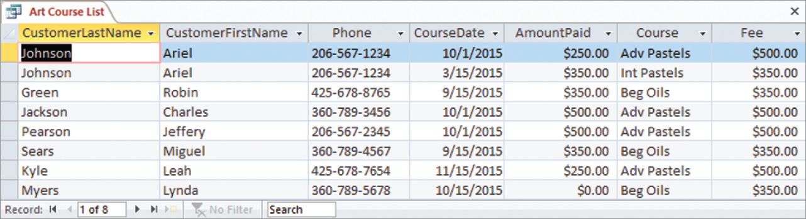
SQL Example Results
Figure 1-13: Results of the SQL Query to Recreate the Art Course List

Slide 21
Database Systems
The four components of a database system are:
Users
Database Application
Database Management System (DBMS)
Database

Slide 22
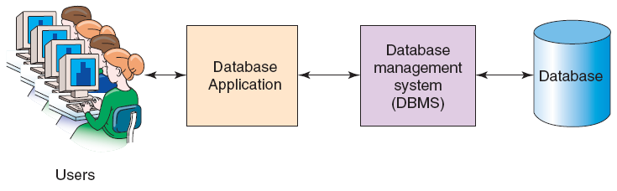
Components of a Database System
Figure 1-15: Components of a Database System

Slide 23
Users
A user of a database system will
use a database application to track things;
use forms to enter, read, delete and query data; and
produce reports.

Slide 24
The Database
A database is a self-describing collection of related records.
The database itself contains the definition of its structure.
Metadata is data describing the structure of the database data.
Tables within a relational database are related to each other.

Slide 25
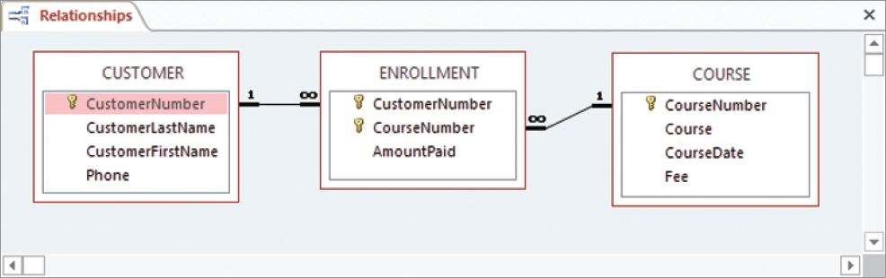
Example Database Metadata: A Relationship Diagram
Figure 1:16 Example Metadata: A Relationship Diagram
for the Art Course Tables in Figure 1-10

Slide 26
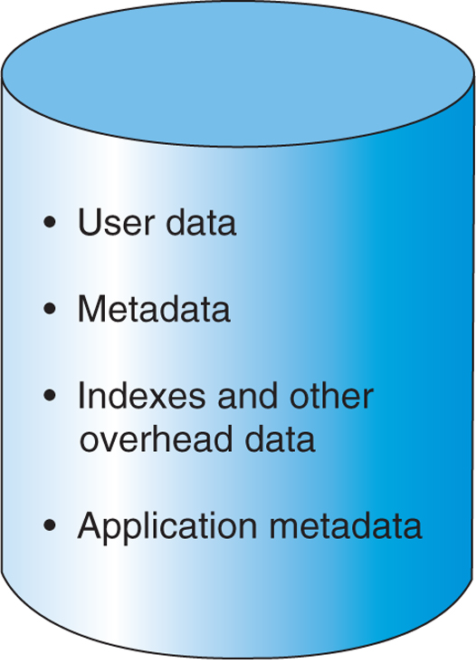
Database Contents
Figure 1-17 Database Contents

Slide 27
Database Management System (DBMS)
A database management system (DBMS) serves as an intermediary between database applications and the database.
The DBMS manages and controls database activities.
The DBMS creates, processes and administers the databases it controls.

Slide 28
Functions of a DBMS
Create databases
Create tables
Create supporting structures
Read database data
Modify database data (insert, update, and delete)
Maintain database structures
Enforce rules
Control concurrency
Provide security
Perform backup and recovery

Slide 29
Referential Integrity Constraints
The DBMS will enforce many constraints .
Referential integrity constraints ensure that the values of a column in one table are valid based on the values in another table.
If a 5 was entered as a CustomerID in the PROJECT table, a Customer having a CustomerID value of 5 must exist in the CUSTOMER table.

Slide 30
Database Applications
A database application is a set of one or more computer programs that serves as an intermediary between the user and the DBMS.

Slide 31
Functions of Database Applications
Create and process forms
Process user queries
Create and process reports
Execute application logic
Control database applications

Slide 32
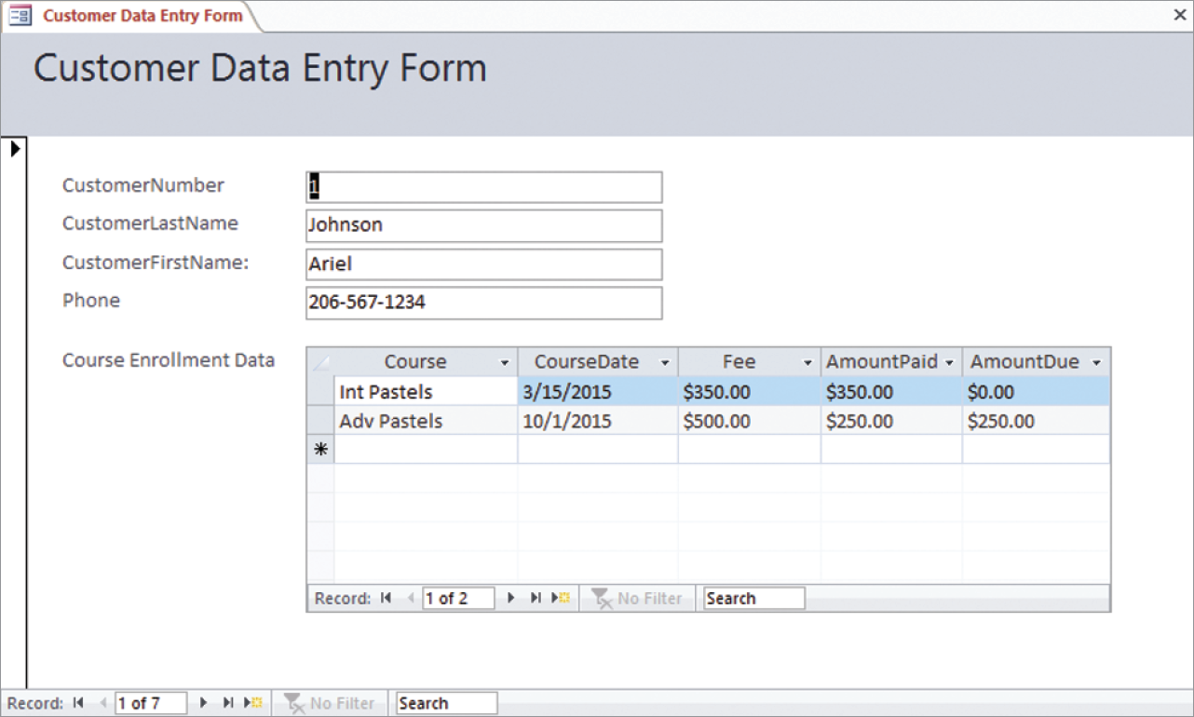
Database Applications: Example Data Entry Form
Figure 1-20: Example Data Entry Form

Slide 33
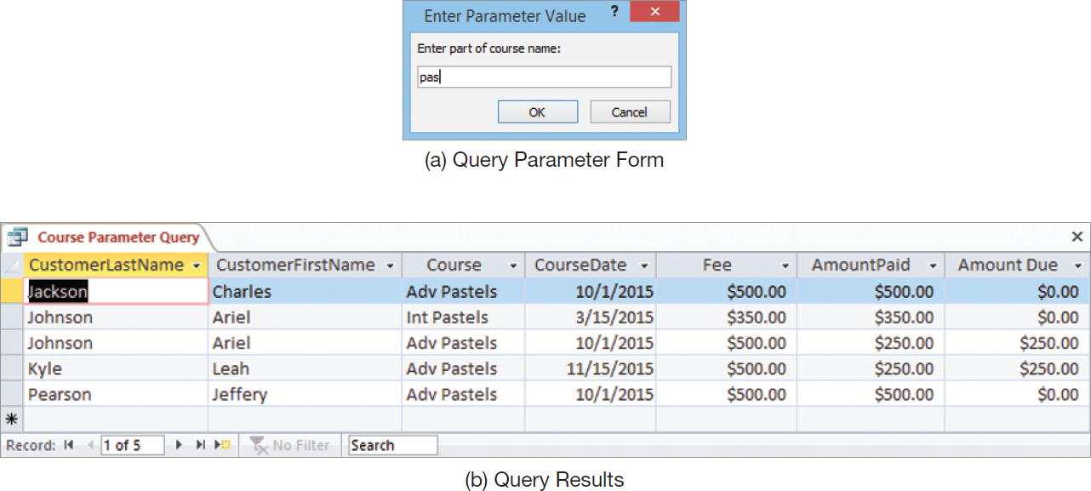
Database Applications: Example Query
Figure 1-21: Example Query

Slide 34
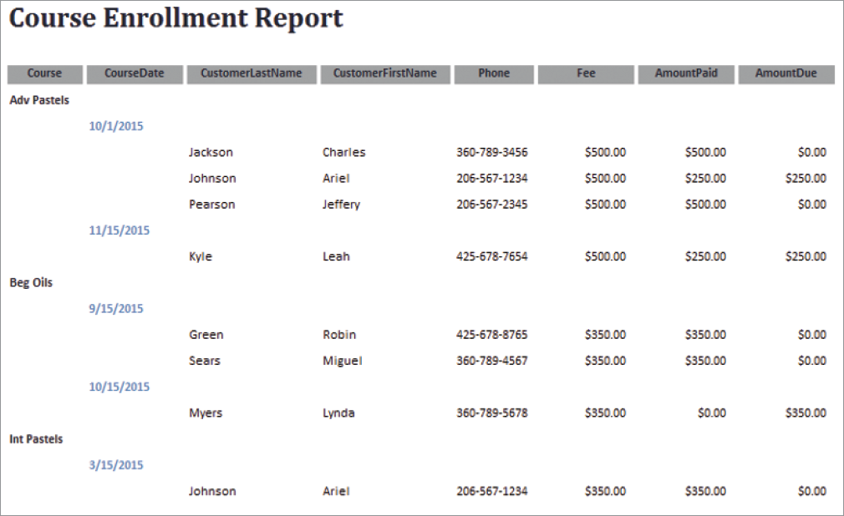
Database Applications: Example Report
Figure 1-22: Example Report

Slide 35
Personal Database Systems
Personal database systems typically
have one application.
have only a few tables.
are simple in design.
involve only one computer.
support one user at a time.

Slide 36
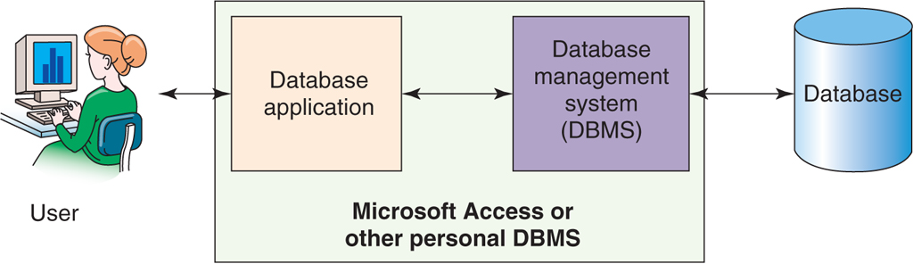
Personal Database Systems
Figure 1-23: Personal Database System

Slide 37
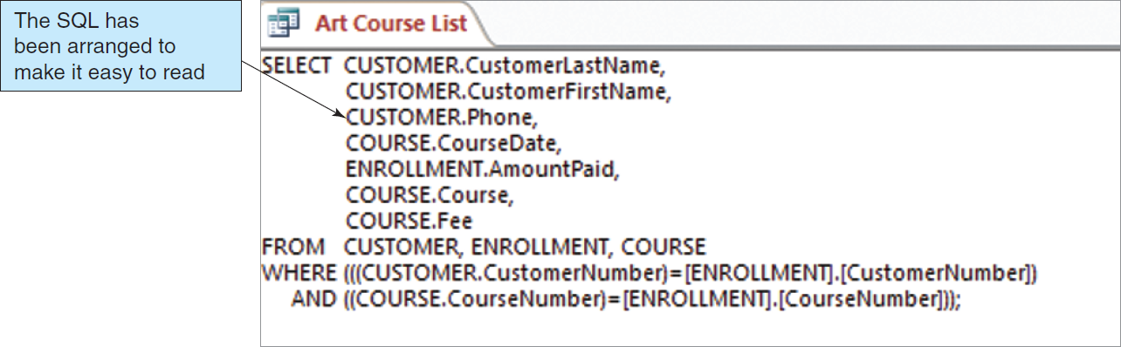
Personal Database Systems: An SQL Query in Microsoft Access
Figure 1-24: SQL Generated by Microsoft Access Query

Slide 38
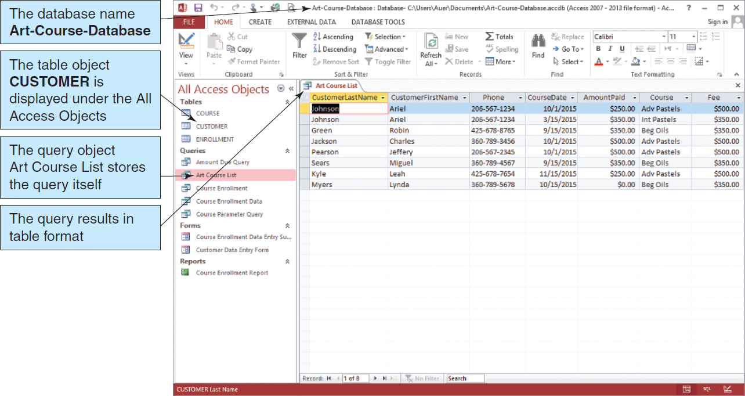
Personal Database Systems: SQL Query Results in Microsoft Access
Figure 1-25: Microsoft Access 2010

Slide 39
Enterprise-Class Database Systems
Enterprise-Class database systems typically:
support several users simultaneously,
include more than one application,
involve multiple computers,
are complex in design,
have many tables, and
have many databases.

Slide 40
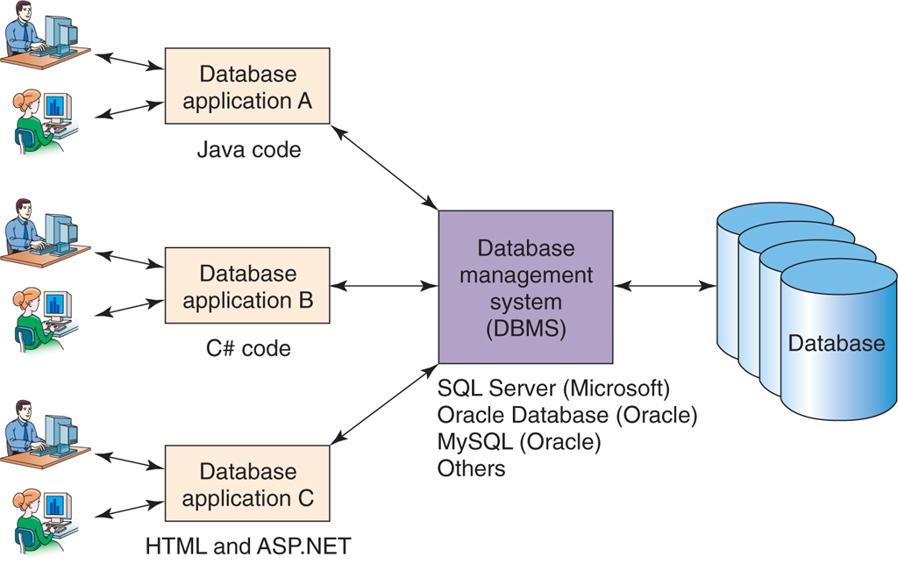
Organizational Database Systems
Figure 1-26 Enterprise-Class Database System

Slide 41
Commercial DBMS Products
Example of Desktop DBMS Products
Microsoft Access
Examples of Organizational DBMS Products
Microsoft’s SQL Server
Oracle’s Oracle
Sun Microsystem’s MySQL
IBM’s DB2

Slide 42
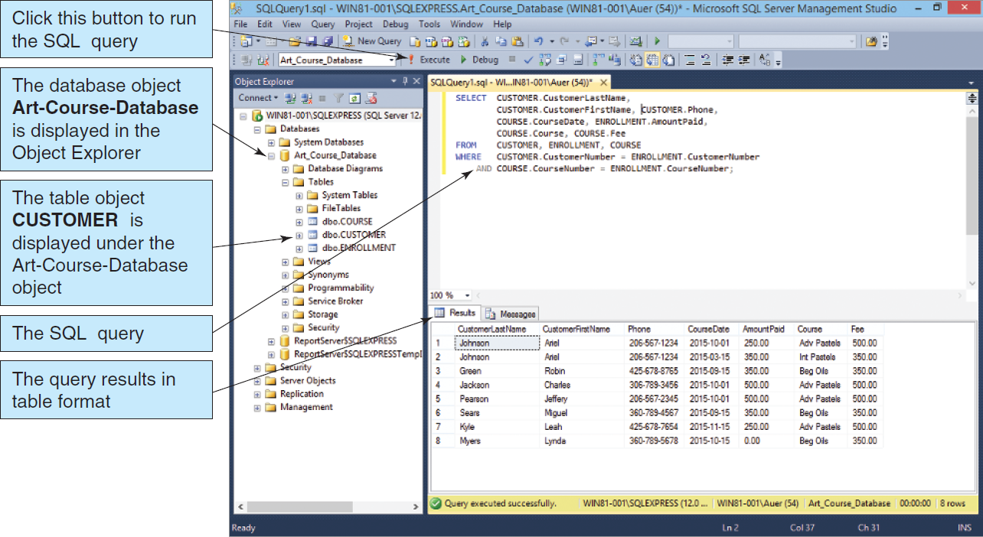
Enterprise-Class Database Systems: Microsoft SQL Server 2014
Figure 1-27 Microsoft SQL Server 2014

Slide 43
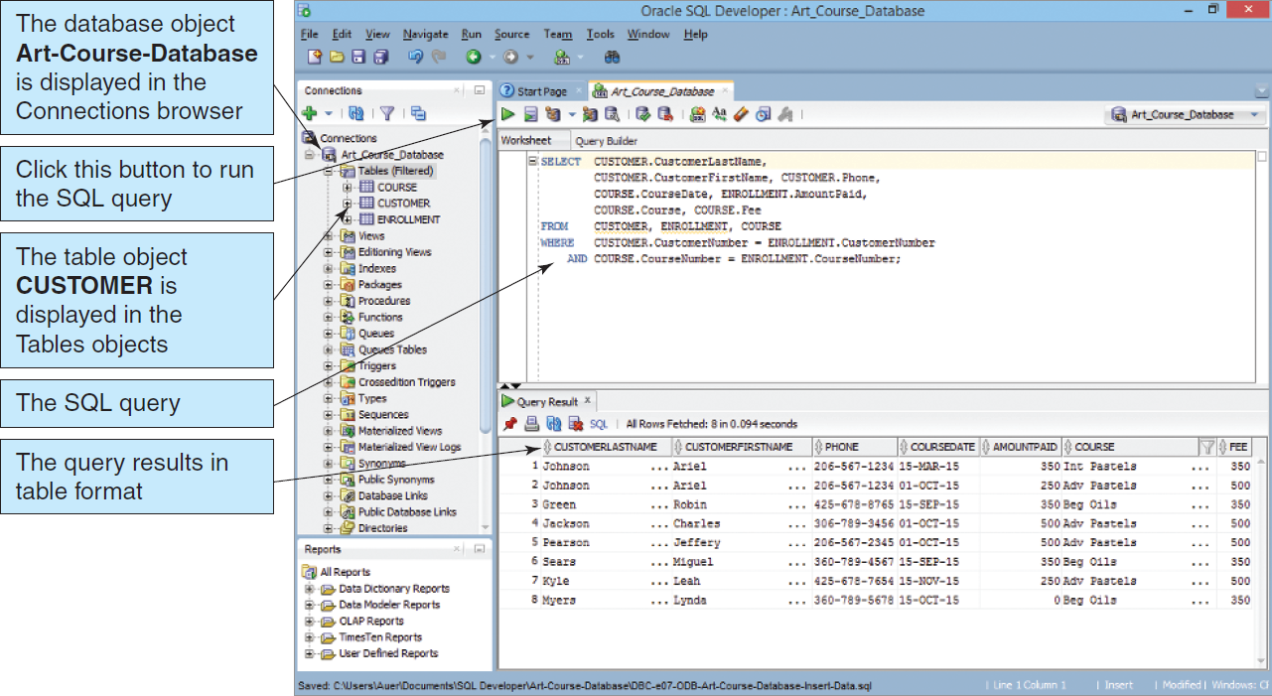
Enterprise-Class Database Systems: Oracle Database Express Edition 11g Release 2
Figure 1-28 Oracle Database Express Edition 11g Release 2

Slide 44
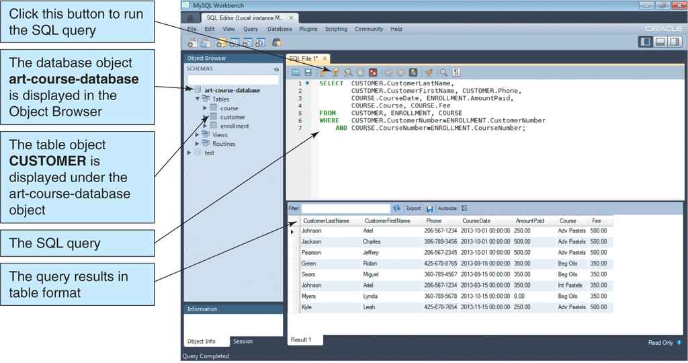
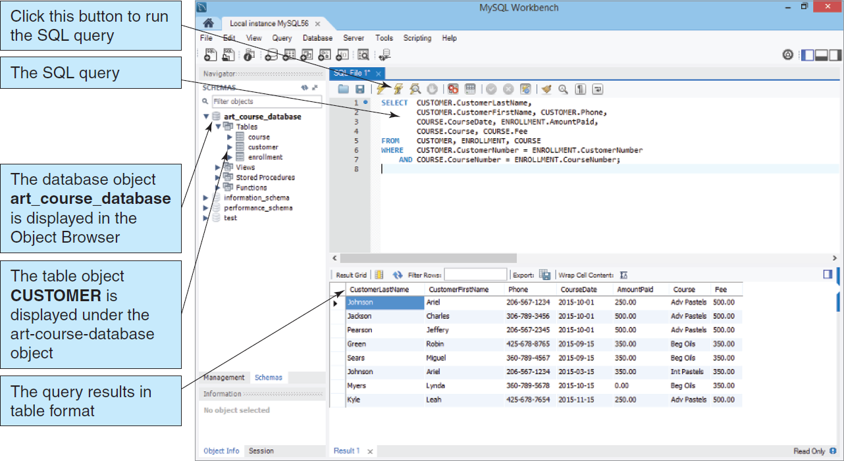
Enterprise-Class Database Systems: MySQL 5.6
Figure 1-29: MySQL 5.6

Slide 45
What is a NoSQL Database?
NoSQL database = Non-relational database
Web 2.0 Applications
Facebook
Twitter
Pinterest
Apache Software Foundation Cassandra
Facebook
Twitter

Slide 46

DAVID M. KROENKE and DAVID J. AUER
DATABASE CONCEPTS, 7th Edition
All rights reserved. No part of this publication may be reproduced, stored in a retrieval system, or transmitted, in any form or by any means, electronic, mechanical, photocopying, recording, or otherwise, without the prior written permission of the publisher. Printed in the United States of America.
Copyright © 2015 Pearson Education, Inc.
Publishing as Prentice Hall

Slide 47
Getting Started
DAVID M. KROENKE and DAVID J. AUER
DATABASE CONCEPTS, 7th Edition
End of Presentation on Chapter One

